Slide 1




PREDICTION OF THE BATTER’S ON-BASE/OUT ACCORDING TO THE PITCHING SITUATION USING MACHINE LEARNING TECHNIQUES
21700365 Son Juchan
21700411 Ahn Dongsu
22000176 Kim Jimin

Slide 2

TABLE OF
CONTENTS
01.
INTRODUCTION
background
research question
project goal
03.
METHODOLOGY
02.
DATA
Proposed Methodology
Analytic Process
Data collection
EDA
Data Pre-processing
04.
RESULTS/DISCUSSION
Results
Future Plan

Slide 3


INTRODUCTION
Background
Research question
Project goal

Slide 4
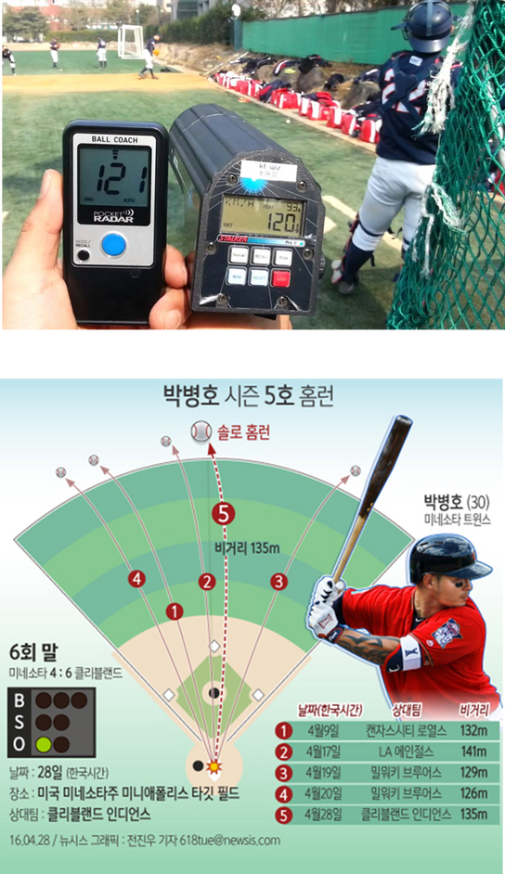
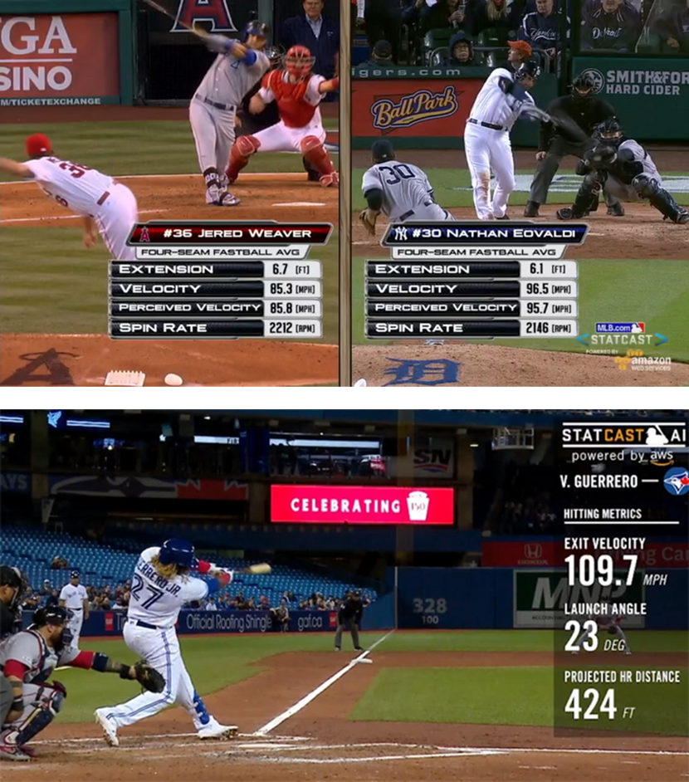

01. BACKGROUND
Simple Statistical Data
Various & Detailed data

Slide 5

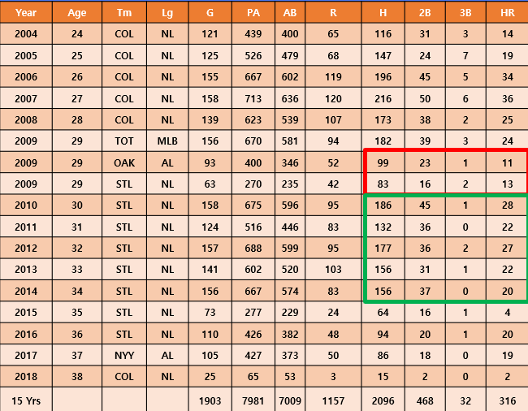
MLB CASE
Matthew Thomas Holliday
He experienced a slump in 2009

Slide 6
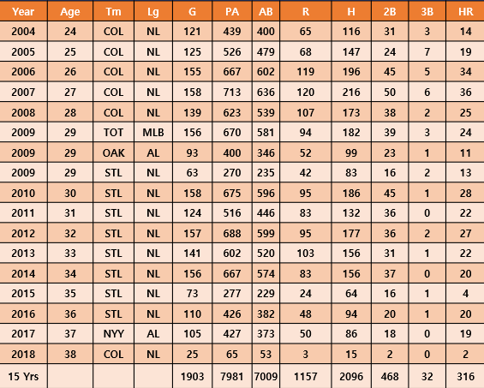
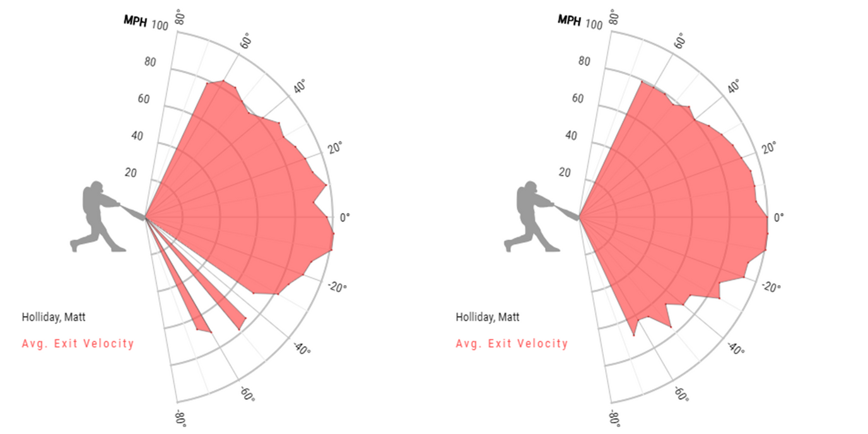
EXIT VELOCITY / LAUNCH ANGLE
Leven swing > Uppercut swing

Slide 7

KBO CASES
Justin Case Haley
William Deck McGuire
Four-seam 2350 rpm
Slider 2625 rpm
Curve 2652 rpm
Extension: 2.06m
Release height : 2.03m
Extension: 2.06m

Slide 8

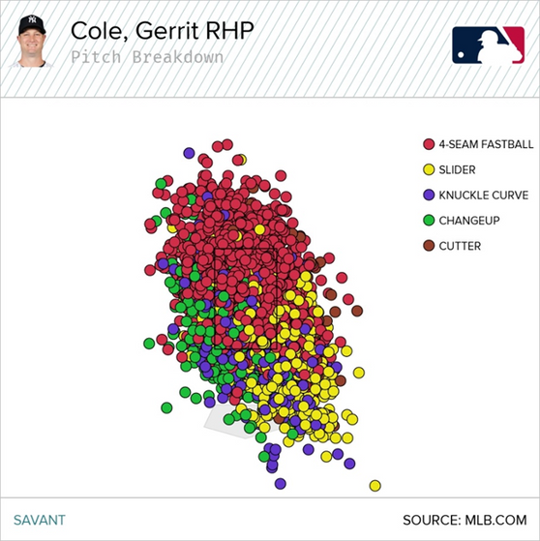
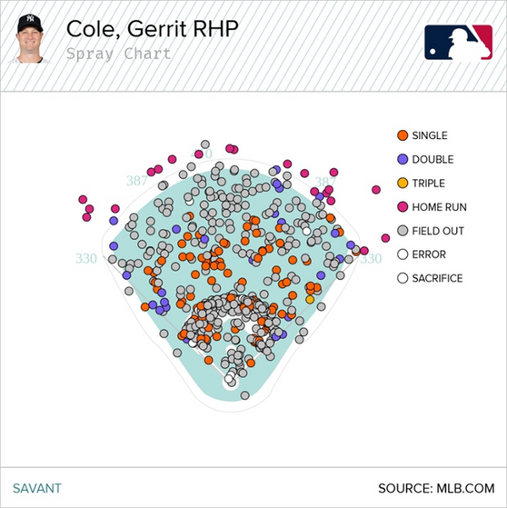
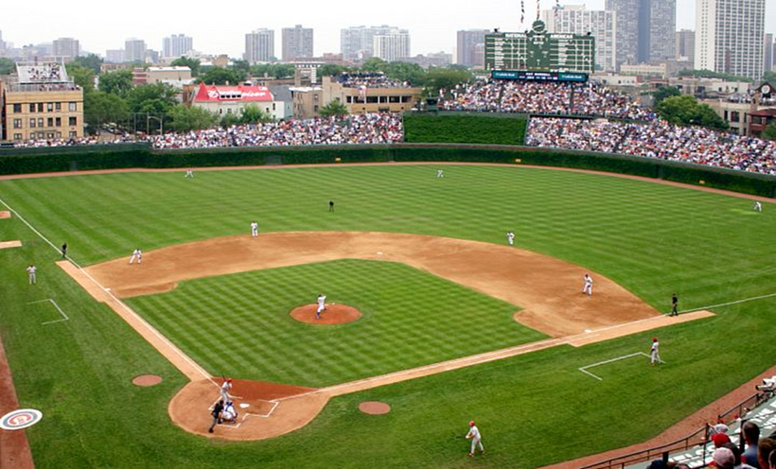
Massive Data is complicated for humans
AI + Baseball

Slide 9
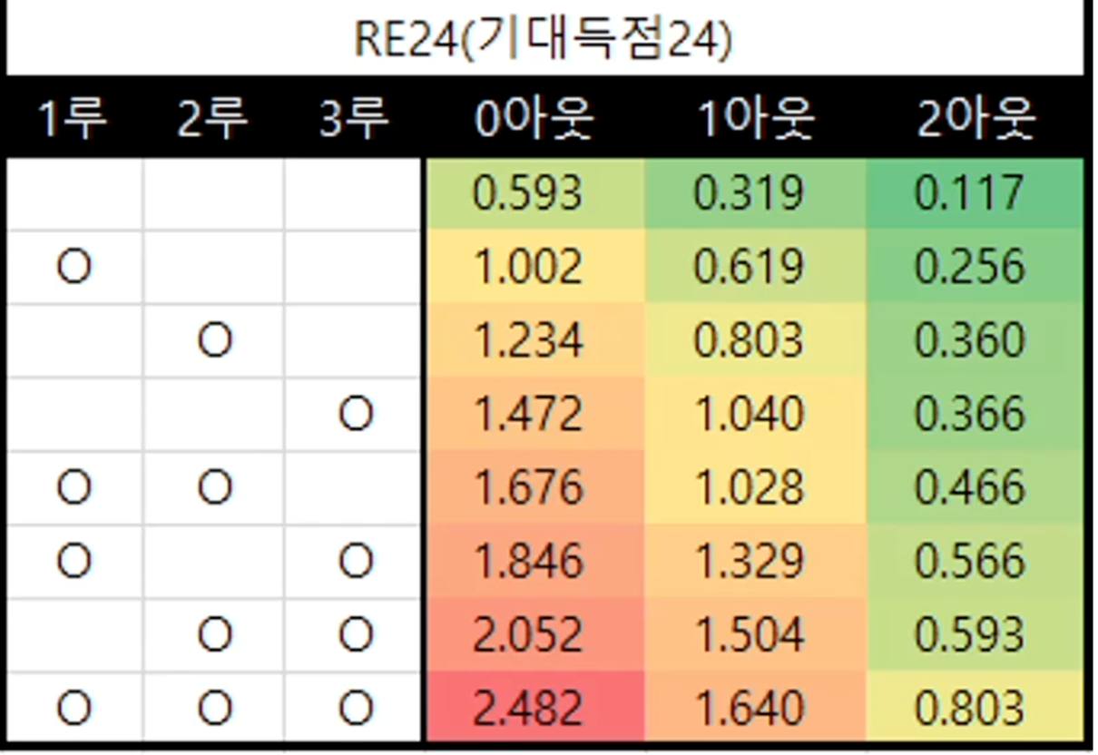
TARGET VARIABLE
Why are on-base or outs important?
In particular, outs and runs are important because each one is associated with winning a score.
A table of expected scoring values based on 15-17 Kbo outings and on-base hits
Score = Win
Scoring leads to victory.
In order to score a lot, you have to get on-base a lot,
The value of the expected score varies depending on the on-base counts.

Slide 10
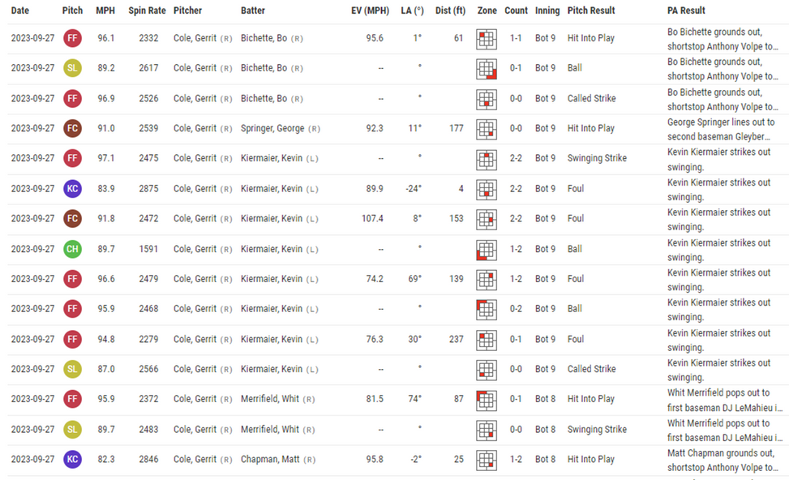

CAPSTONE TOPIC :
PREDICTION OF THE BATTER’S ON-BASE/OUT ACCORDING TO THE PITCHING SITUATION
ON BASE
VS
OUT

Slide 11

DATA
Data Collection
EDA
Data Pre-processing

Slide 12

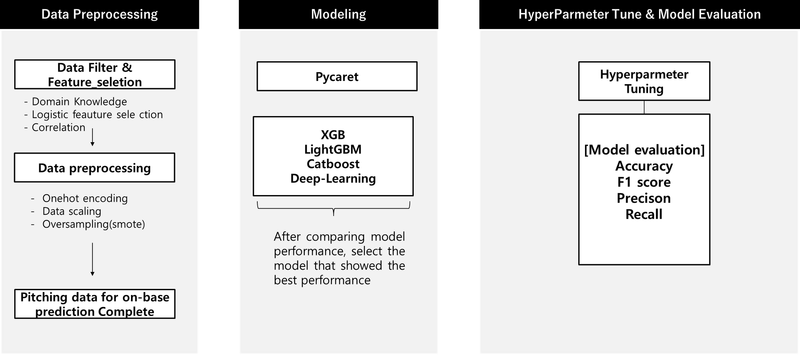
MODEL FLOW

Slide 13
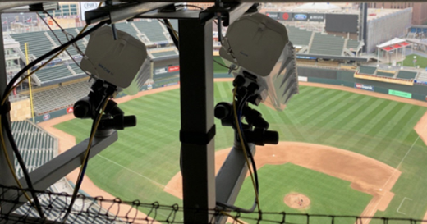


01. DATA COLLECTION
Data collected by using the Hawk-eye statcast sytem(equipment) to record the ball’s movement, velocity, position, and etc.
Used Data:
Pitching records from 3 seasons of games
30 Teams
Raw data shape : (421879, 92)
Baseball Savant:
Official record-keeping site for Major League Baseball (MLB)
baseballsavant.mlb.com

Slide 14

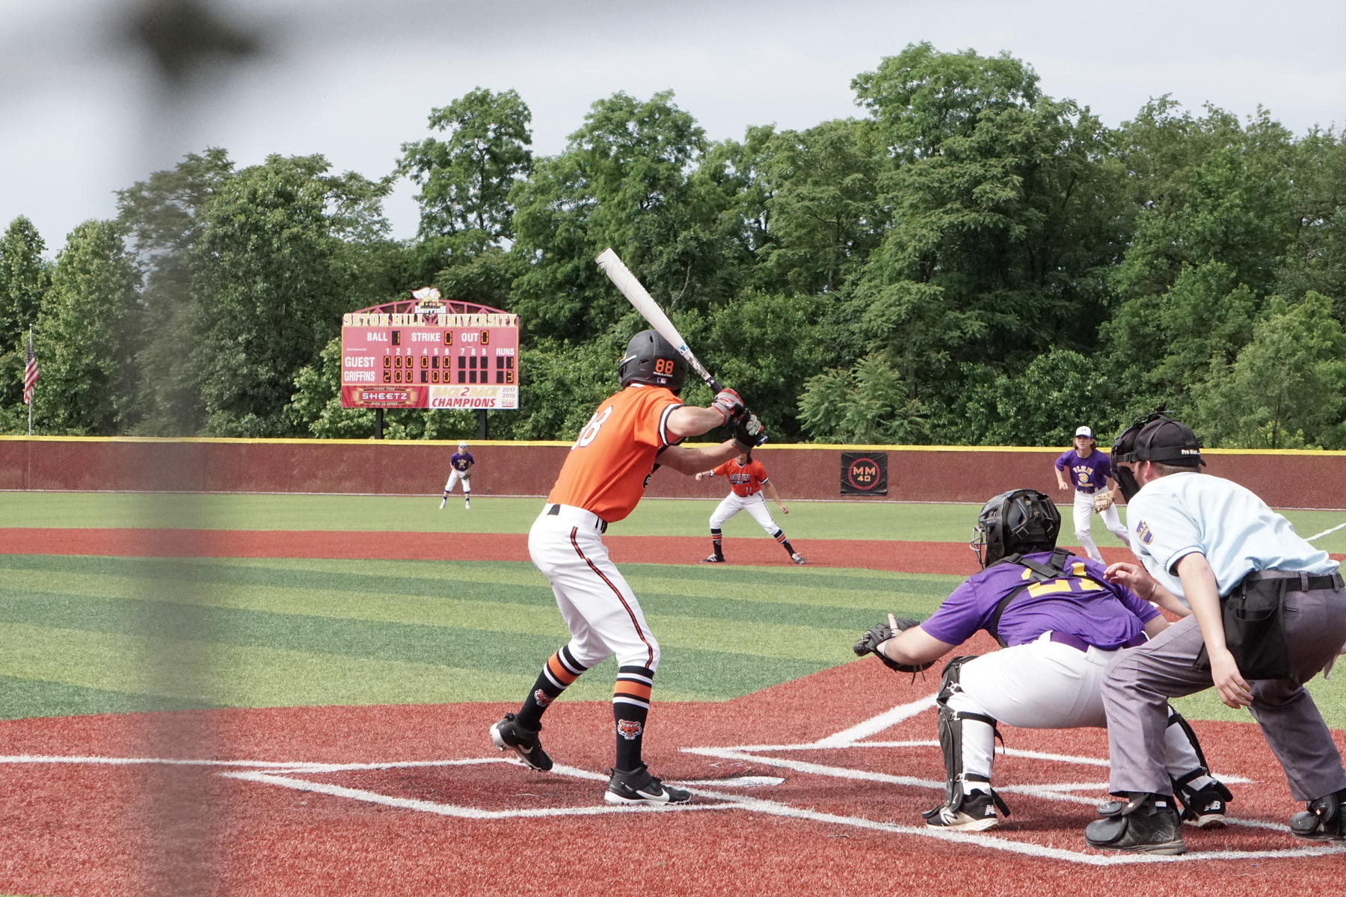
02. RAW DATA PROCESSING
1) Delete columns that are not needed for domain knowledge (refer to mlb, machine learning, previous papers, etc.)
Ex) Delete records about the batter, batter's name, pitcher's name)
Delete columns with too many Na values or empty columns.

Slide 15
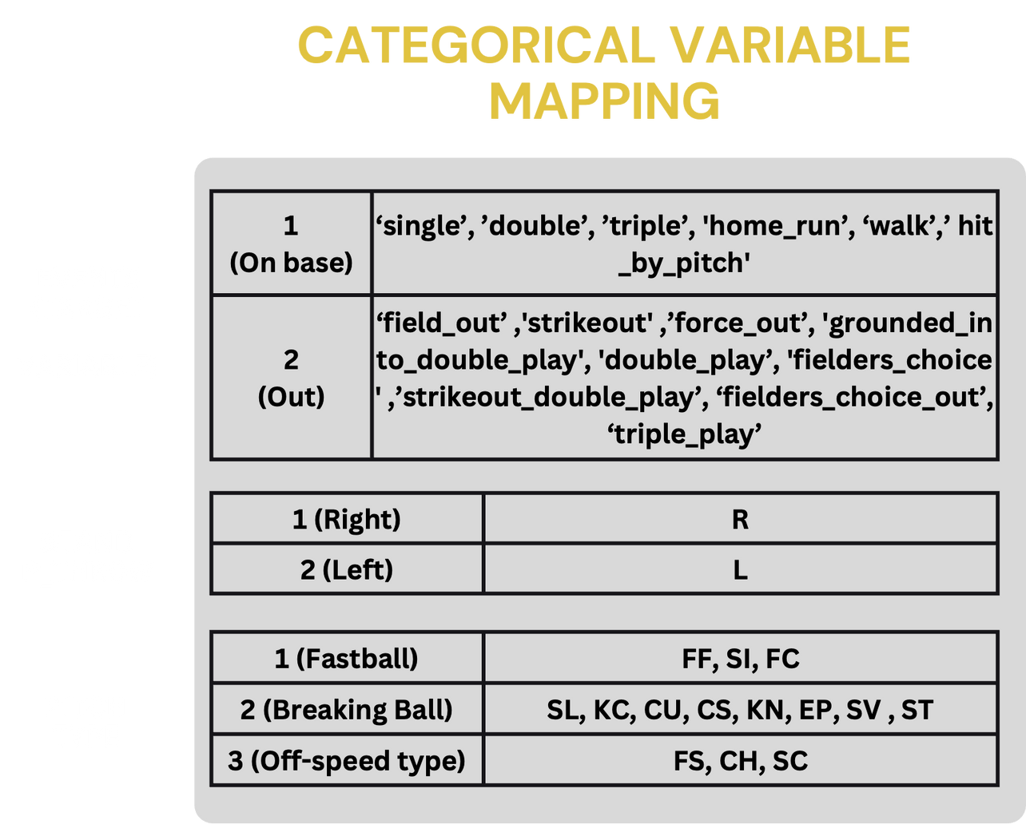
02. RAW DATA PROCESSING

Slide 16
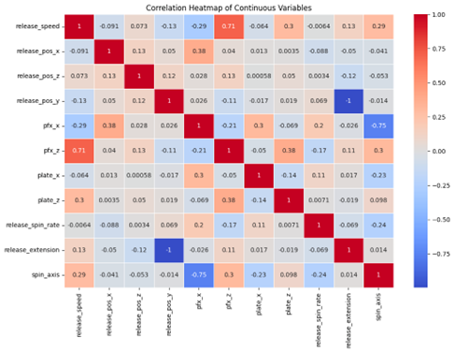
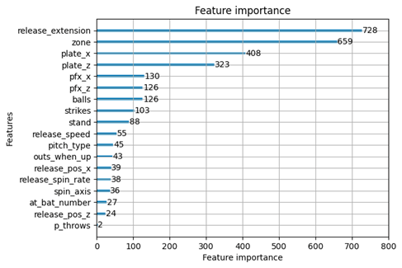
02. EDA & FEATURE SELECTION
Correlation
(multicollinearity between independent variables, etc.)
Logistic regression variable selection method (AIC)
Feature importance using xgb, lgbm
-> Choose the best combination of variables that performs best
Using
FOR LOOP

Slide 17
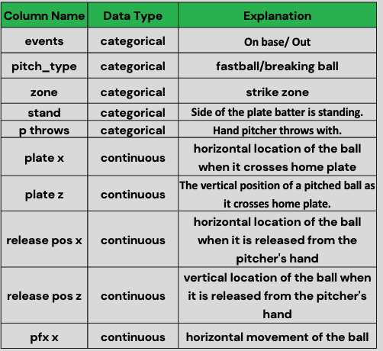
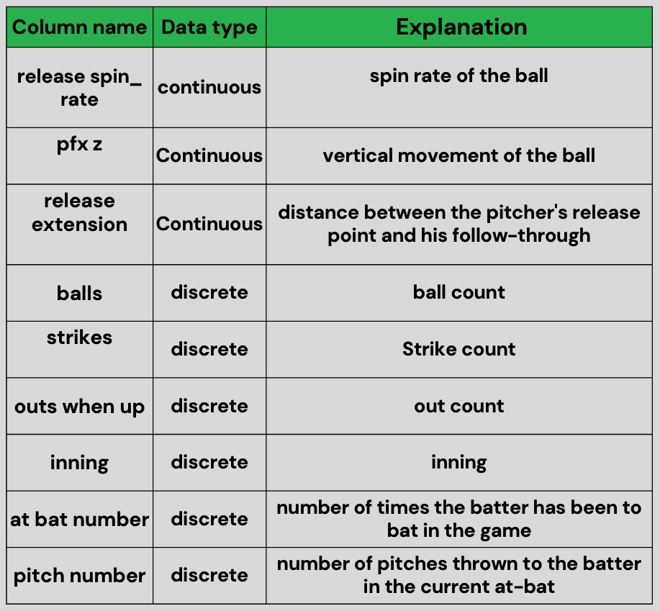
03. FINALIZED VARIABLES
y
x

Slide 18
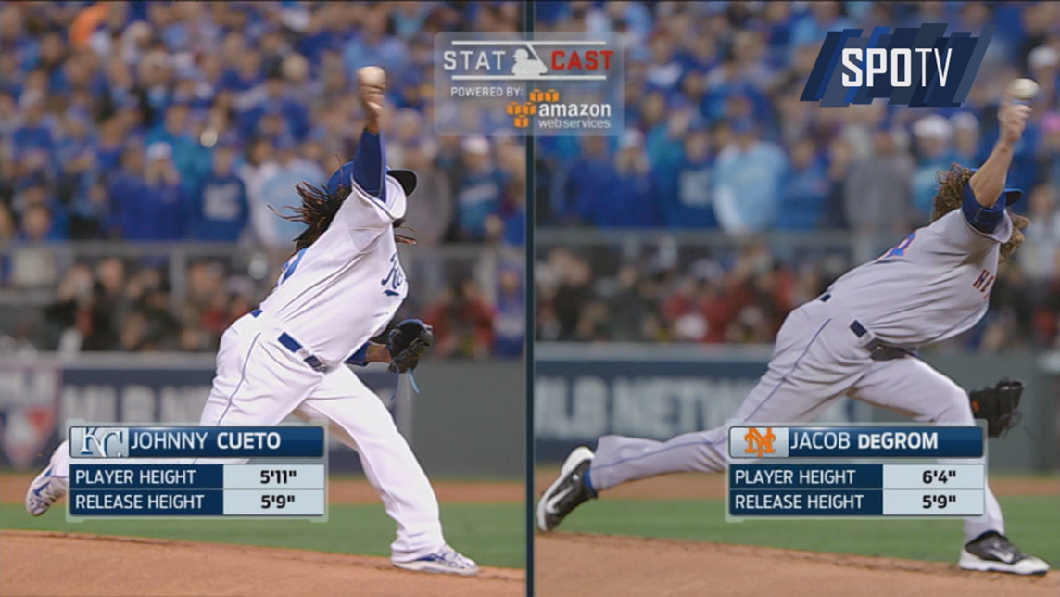

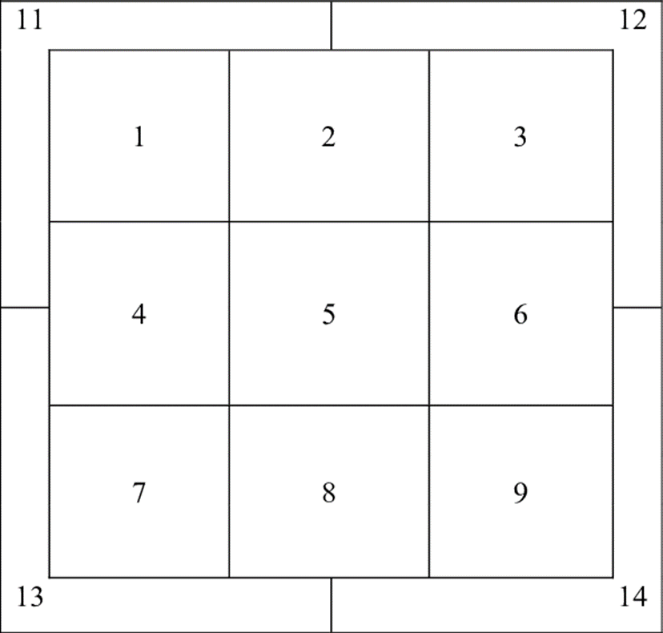
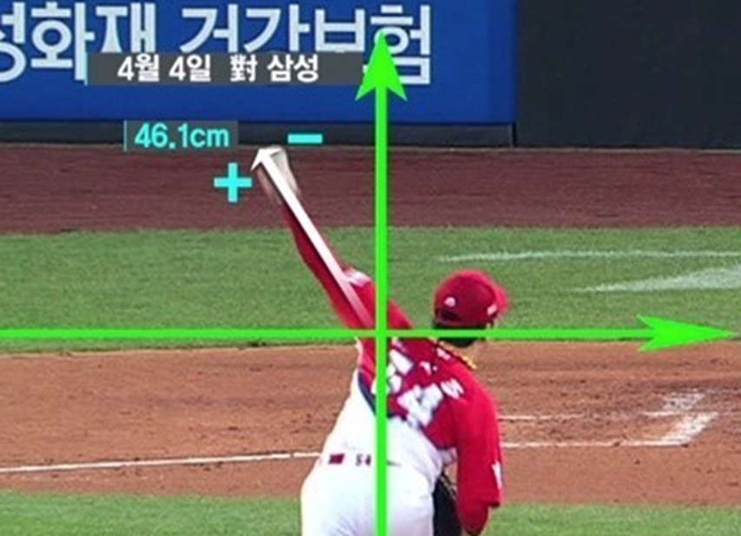
Y
X

Slide 19

4-1. DATA CLEANSING

Slide 20
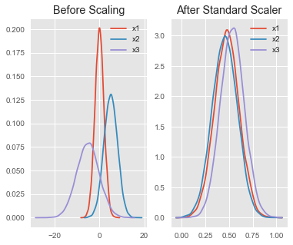

4-2. DATA CLEANSING
DATA SCALING
ONE-HOT ENCODING
Data scale different by column
Converting categorical data to 0,1
use standard scaler library from sklearn library
Scales the mean of the attributes to 0 and the variance to 1 (normal distribution)
ID | Pitch_type
1 | Pitch_type_1 (Fast ball)
2 | Pitch_type_2 (Breaking ball)
3 | Pitch_type_3 (Off-speed)
ID | Pitch_type_1 | Pitch_type_2 | Pitch_type_3
1 | 1 | 0 | 0
2 | 0 | 1 | 0
3 | 0 | 0 | 1

Slide 21
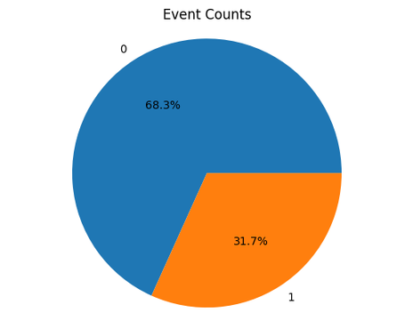
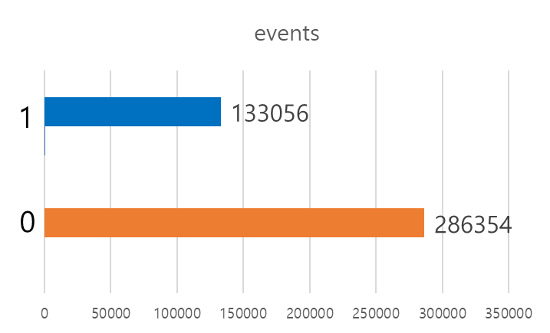
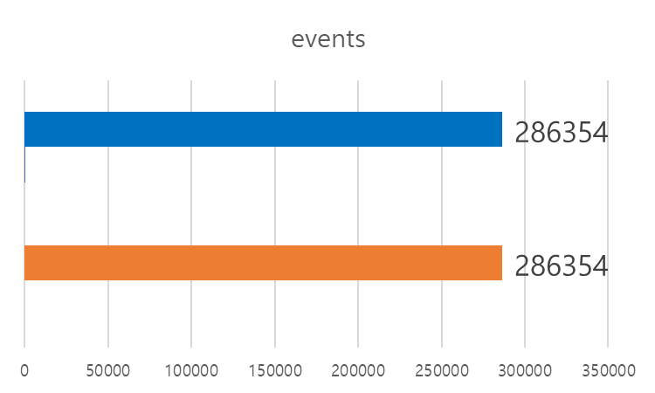
68.3%
4-3. DATA CLEANSING
OVERSAMPLING
31.7%
balancing data imbalance by increasing the number of data in low percentage classes by using SMOTE methodology
SMOTE generates new data by using the nearest neighbors of the low percentage class data.

Slide 22
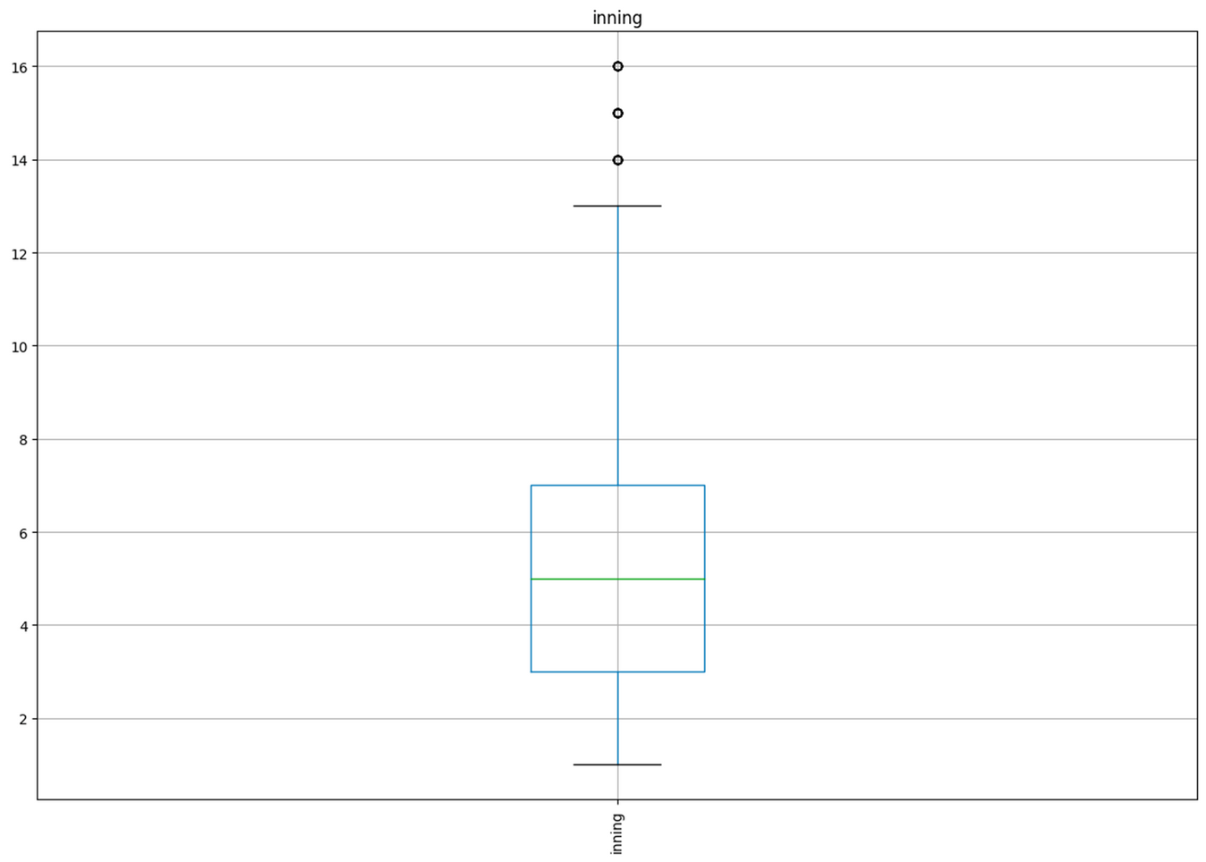

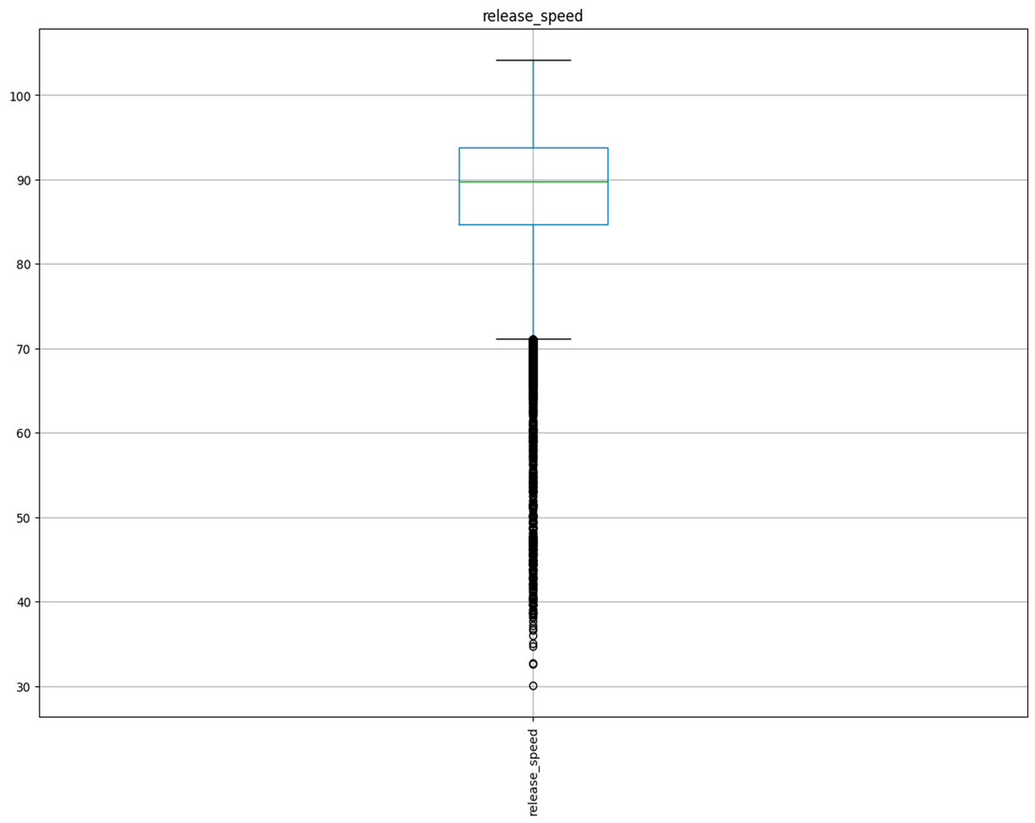
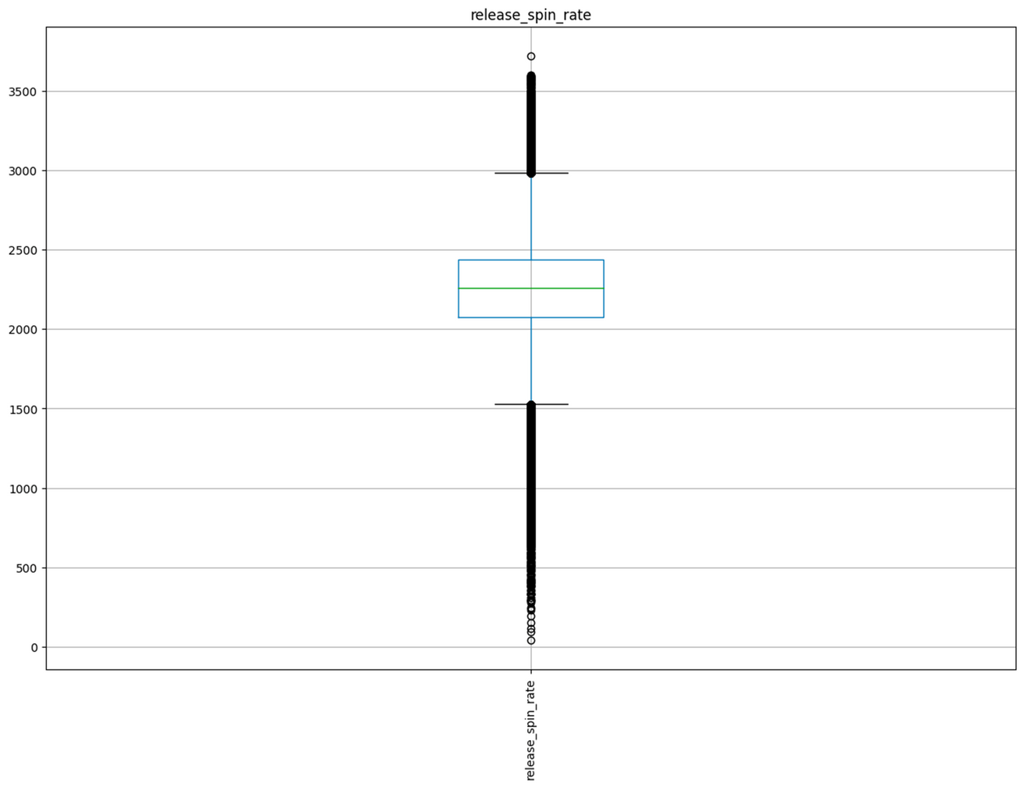
4-1. DATA CLEANSING
OUTLIERS
Inning
release speed
release_spin rate

Slide 23


METHODOLOGY
Methodology
Analytic Process

Slide 24

01. MODEL FLOW

Slide 25
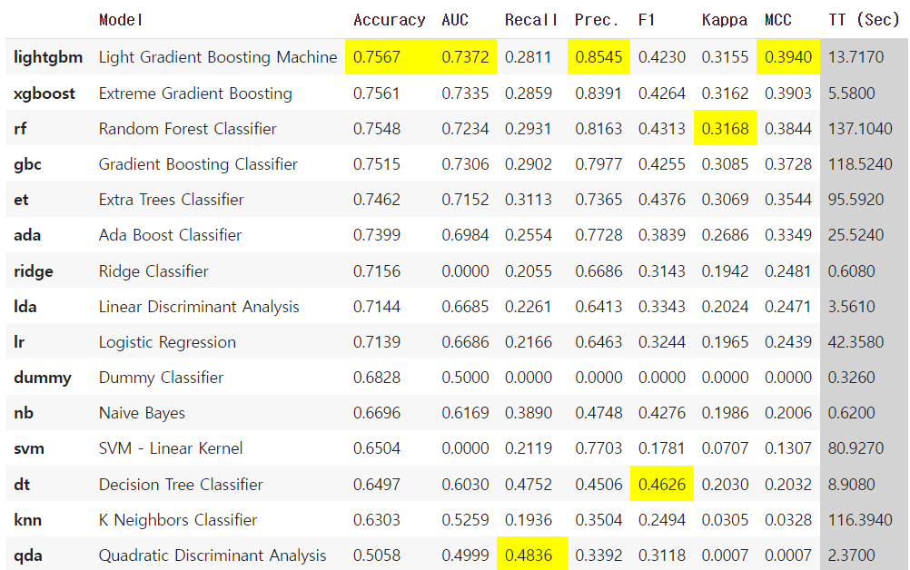
Pycaret
Library

Slide 26

MODELLING RESULTS

Slide 27
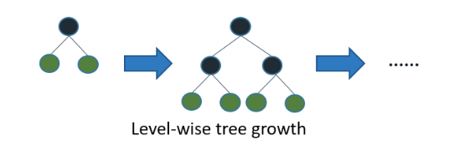
XGBOOST
ensemble algorithm that combines multiple decision trees
Numerous baseball sports papers have utilized XGBoost for research purposes
[Thesis]
Analyzing situational factors affecting barrel hits using pitch records in Major League Baseball (MLB) in the United States
Research on predicting audience attendance in professional sports using machine learning methods
Predicting a KBO hitter's OPS using big data analysis with machine learning.

Slide 28
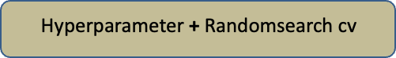
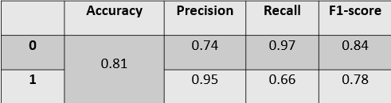

(Focus) tune parameters to avoid overfitting
lower ETA
increase num_boost_round
increase n_estimators
lower max_depth
increase min_child_weight
increase gamma
lower subs_ample, colsample_bytree
Hyperparameters Range
'learning_rate': (0.01, 0.5)
'n_estimators': (100, 1000),
'max_depth': (3, 10),
'min_child_weight': (0, 10)
'subsample': (0.5, 1.0)
'colsample_bytree': (0.5, 1.0)
'gamma': (0, 5)

Slide 29


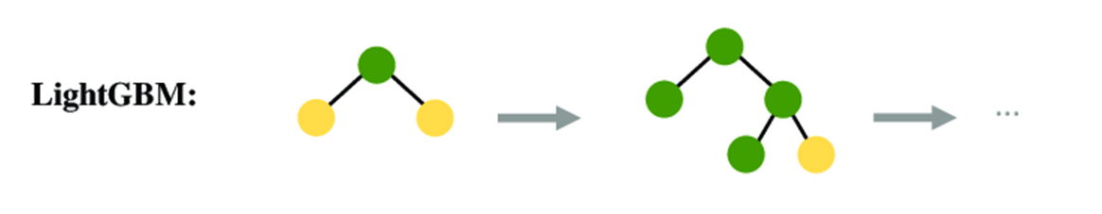
LGBM
LightGBM is an ensemble model that combines multiple decision tree models using boosting.
In the tree creation process during training, it utilizes a Leaf-wise method. LightGBM significantly reduces training time compared to XGBoost while generally ensuring performance.
widely used in various baseball sports papers, Kaggle, and more.
ex)
Baseball Salary Prediction
Predicting the potential of soccer players
Predicting transfer fees of FIFA players

Slide 30
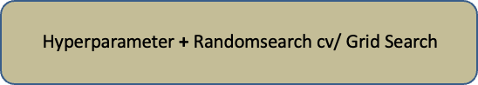
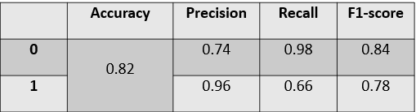
(Focus) For better accuracy :
use bin (speed may be slower)
use small learning_rates with large num_iterations
use big num_leaves (may lead to overfitting)
use larger training data
use dart
use categorical features hyperparameter
Hyperparameter
Range
n_estimators = 100, 300, 500
learning rate: 0.1 -> 0.05 ->, 0.04,-> .0.03
boosting : GBDT , DART
[Tree]
Max_depth : 5-12
min child_sample : no effect
num_leaves(d=32~64)
[Sampling]
sub_sample : 0.5 -1
Colsample_bytree : 0.5 -1
Best Hyperparameters :
{'colsample_bytree': 0.8, 'learning_rate': 0.1,' MAX_DEPTH': 5, 'N_ESTIMATORS': 500, 'NUM_LEAVES': 32, 'SUBSAMPLE': 0.5}

Slide 31
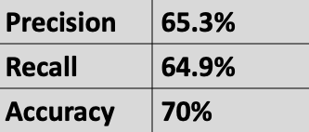
Input Layer
DNN
Dense Layer 1
Dropout 1
ReLu
Activation
hidden layer
Dense Layer 2
Dropout 2
ReLu
Activation
the performance of deep learning improves as the amount of data increases, but it may decrease if the amount of data is small.
Output Layer
Sigmoid Activation

Slide 32
RANDOM FOREST
GRADIENT BOOST
CLASSIFIER
Hyperparameters
max_depth': None
'min_samples_leaf': 1,
'min_samples_split': 2
'n_estimators': 200
Hyperparameters
n_estimators = 100, 300, 500
learning rate: 0.1 -> 0.05 ->, 0.04,-> .0.03
Accuracy: 74.12%
Precision: 67.06%
Recall: 35.95%
F1 Score: 46.82%
Accuracy: 73.13%
Precision: 66.06%
Recall: 30.95%
F1 Score: 42.81%

Slide 33
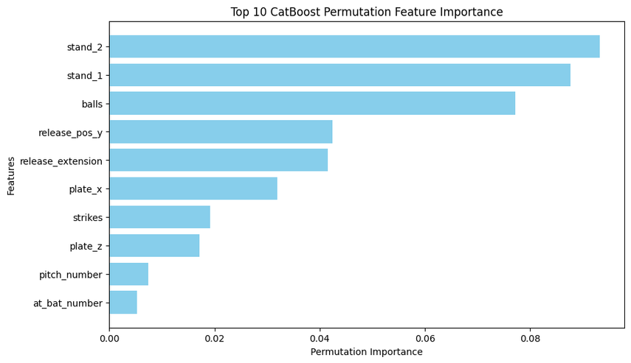
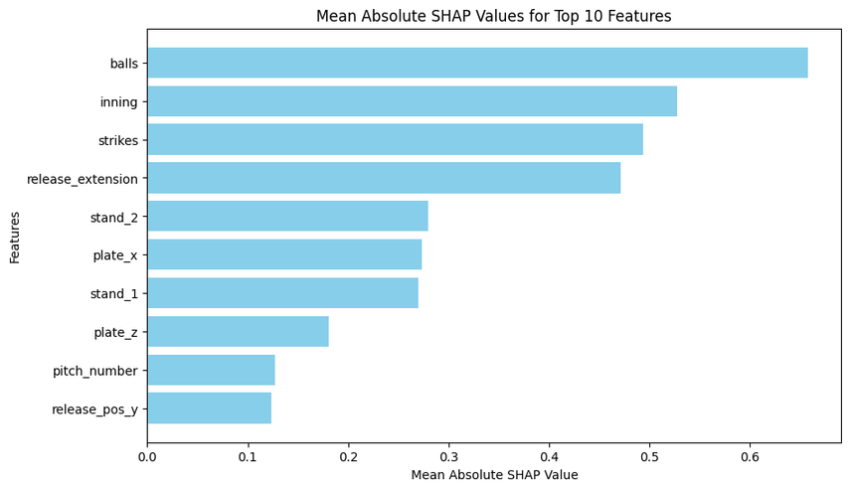
CATBOOST
Hyperparameters
'learning_rate': 0.05,
'l2_leaf_reg': 1,
'depth': 6
Model Evaluation:
Accuracy: 75.82%
Precision: 83.462%
Recall: 29.48%
F1 Score: 43.58%

Slide 34
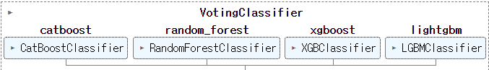
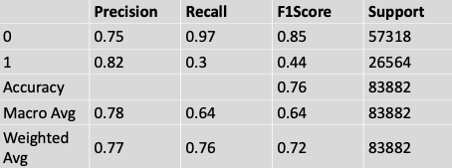
ENSEMBLE
ensemble model : combines four different models (CatBoost, RandomForest, XGBoost, and LightGBM) to make the final prediction.
Bagging : creates an ensemble model by computing a weighted average of predictions from each model

Slide 35
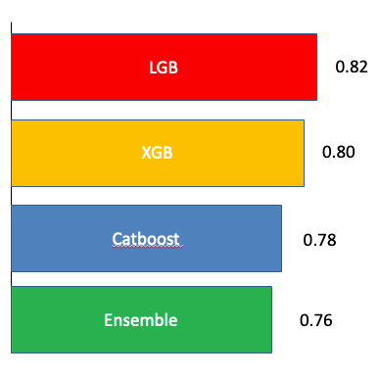

RESULTS/MODEL PERFORMANCE
Accuracy

Slide 36

FUTURE PLANS

Slide 37
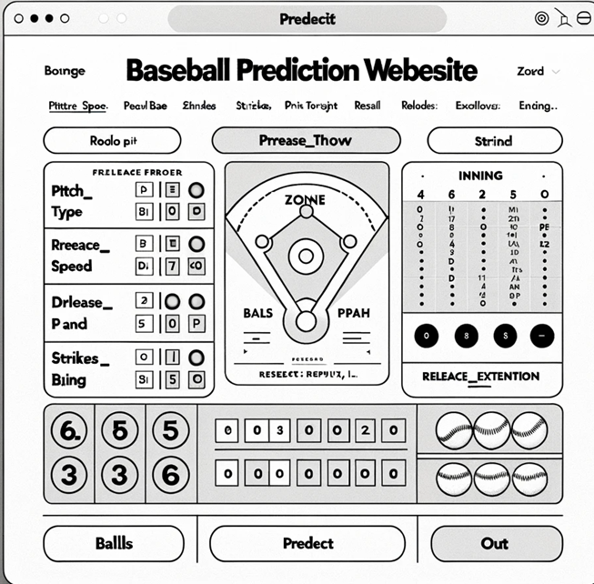

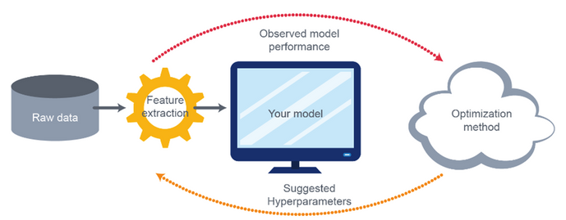
PROJECT GOAL & FUTURE PLAN
paper submission
Prototype
Attempt to improve model performance
Hyperparameter tuning, feature engineering, and finetuning
Generating derivatives and subdividing predictors

Slide 38
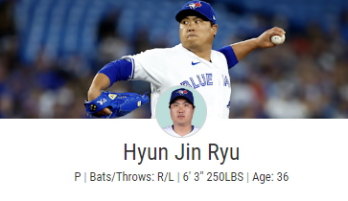

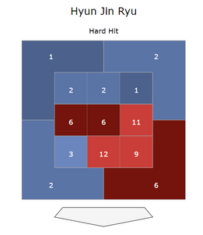
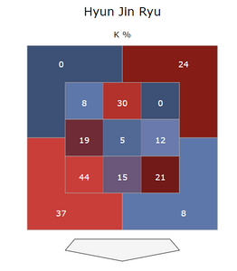
PROJECT GOAL & FUTURE PLAN
Prototype
Inning | Strike | Ball | Releas Speed | Releas Extension | ... | Spin Rate | Zone
5 | 2 | 1 | 90 | 99 | ... | 2400 | 3
INPUT
RESULT
ON_BASE

Slide 39


THANK YOU

